Slide 1
Church Centre Development Group
APCM presentation 24th May 2021

Slide 2
Members of Church Hall Development Group
Derrick Claridge: Joint Chair
Douglas Ogram: Joint Chair
Sarah Gunn:

Slide 3
30th March: Initial Meeting with Andrew
Our Vision should be the driving force in forming any decisions we make.
The Centre must remain open for services, lettings etc.

Slide 4
Our Vision

Slide 5
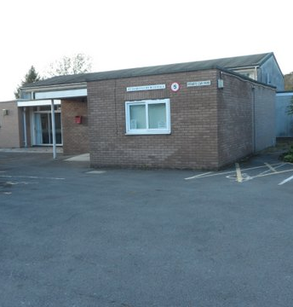
Welcoming
A Hall
Yes
In the right place
Yes
Good facilities
Yes
Welcoming
?

Slide 6
Our Suggestion Phase 1A
Paint all visible brickwork in Cornish Cream.
Include the side wall facing the Strawberry Line.
Our new logo and name
Flower, bees and butterflies cut from plywood
Foliage painted directly onto walls
Handprints for grass

Slide 7
The Why and How of Phase 1A
Our Objective : to make the Church Hall at the HEART OF OUR COMMUNITY!
Re-branding: OUR CHURCH CENTRE.
A community inclusive project which gives all who get involved OWNERSHIP.
Projected cost: £200 for materials.
Who will do the work?
Members of the church community and beyond
Involvement of children in designing and painting flowers, butterflies and bees
Railway sleepers donated to make planters
Funding: Grants or donations to Church Centre Fabric Fund

Slide 8
Our Suggestion Phase 1B
Main Hall Curtains
All in poor condition
Replace all except stage curtains
High Window Curtains x 9 pairs
Fully lined plain blue fabric
Cost per window. £60.00
Alcove Curtains x 2 pairs
Fully lined patterned fabric
Cost per window £175

Slide 9
The Why and How of Phase 1B
Why?
To make the centre brighter and smarter!
How?
Making the curtains
Volunteer found to co-ordinate project
Other sewers needed to help
Will need help to remove old curtains / hang new
Funding the Curtains
Invite sponsorship from the church community
Individually or jointly sponsor a window
For the Future
Re-painting the hall

Slide 10
Our Suggestions Phase 1C
Caring
Serving
Teaching
We need:
A practical small meeting room
How can we achieve this using our current space?
Create a flexible space using existing alcove
An extension? Long term
We are aware that this suggestion is the most expensive one made so far at
£3,200, however we are convinced that over the next few years this cost will prove to be a
very sound investment.

Slide 11
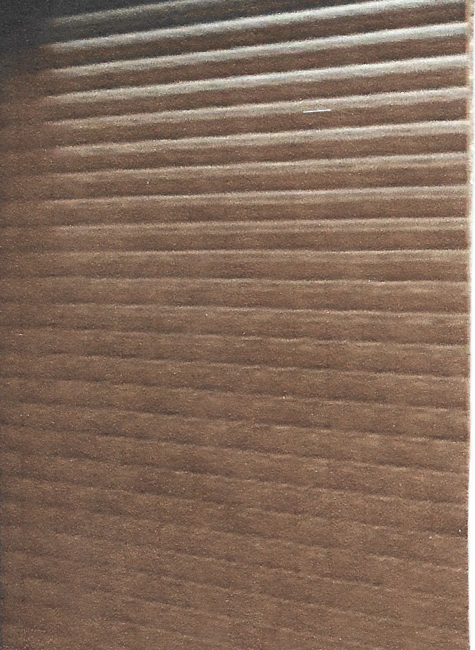
The Why and How of Phase 1C
Why?
Supports the vision
Space for:
Meetings
Training Sessions
Surgeries
Café
Community services (e.g. Citizens’ Advice)
Children’s and youth activities
Alpha courses
How?
Utilise the alcove
Fit electrically operated roller shutters
Cost
£3200.00

Slide 12
Our Suggestions Phase 1D
The ‘Back Room’
Remove storage cupboards etc.
Provide a flexible area
Could be used used as
an office space
chair storage area
teaching area for the children during services
The Youth Cupboard
Consolidate equipment stored currently – consulting with current users
Use to store table tennis table etc.

Slide 13
The Future
Phase 2
In the Medium Term - An Extension?
Phase 3
Long Term - The Whole Site ?

Slide 14
What next?
Identify sources of grants for longer term projects
Consult key people across the community
those who have previously made suggestions
key users and groups
Work on medium and long term plans to create a Church Centre to help fulfil the vision
Develop an initial report for the PCC by September 2021
So Please …..
support our plans in anyway that you can
contribute your ideas

